Slide 1
Lecture02
Asking good questions and gathering reliable evidence Dr Gordon Wright

Slide 2
Key topics today
The week ahead
Some Induction Week Poll insights [in the lecture]
The research process you are beginning
A couple of CHIP topics to vote on
Lab preview - The process, time-management and teamwork

Slide 3
The week ahead
This week (week 2) you have your Social Psychology Essay Tutorial
“Sexual Economics: Theory and Patriarchy”
“Is sex a female commodity that women exchange for men’s resources? Advantages and disadvantages of applying social exchange theory to understanding heterosexual relationships.”
Deadline 10am Friday 21st October (end of week 3)
Feedback on/by 11th November
Notes:
Mention Roy Baumeister. A very creative Psychologist

Slide 4
Induction Week Poll

Slide 5
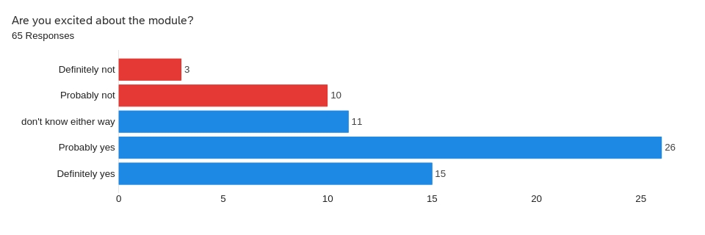

Slide 6
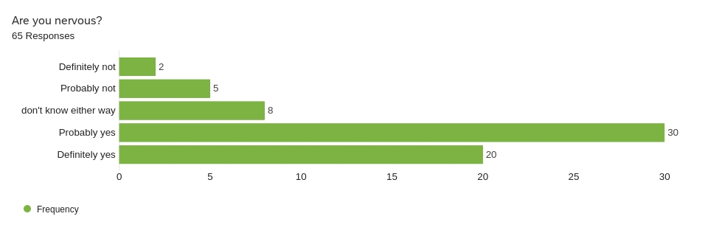

Slide 7
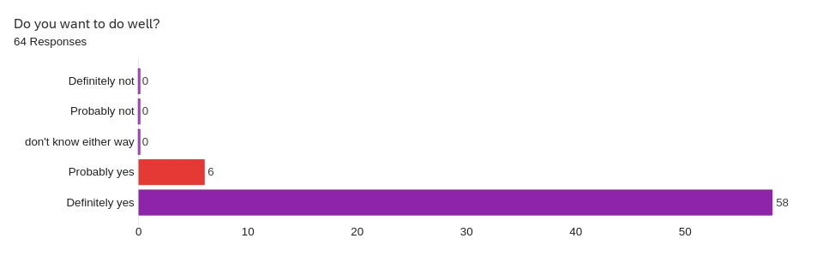

Slide 8
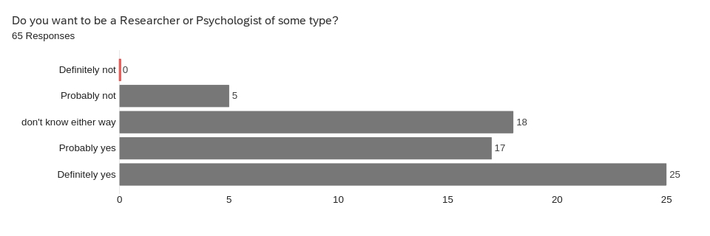

Slide 9
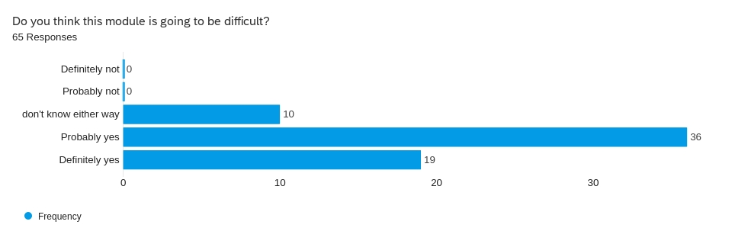

Slide 10
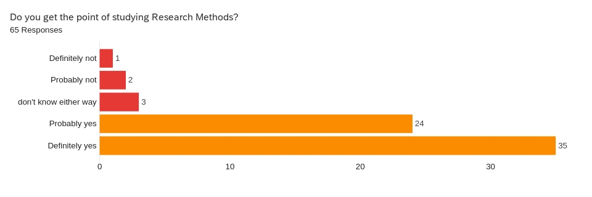

Slide 11
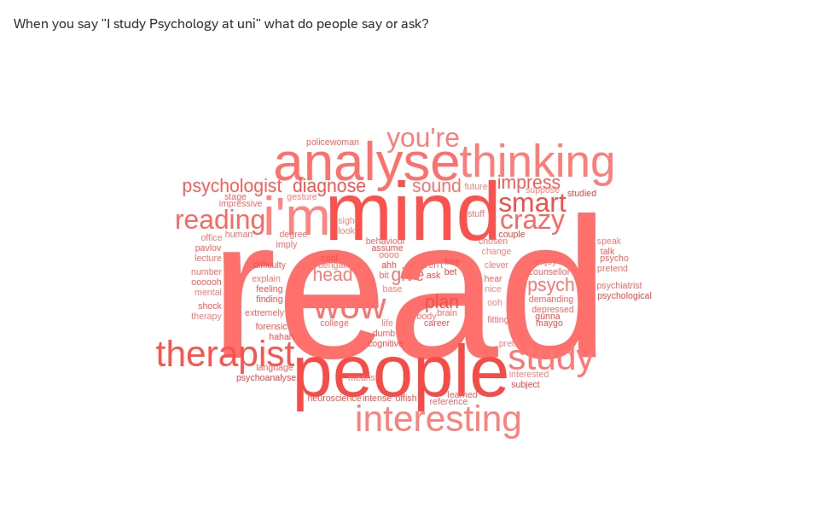

Slide 12
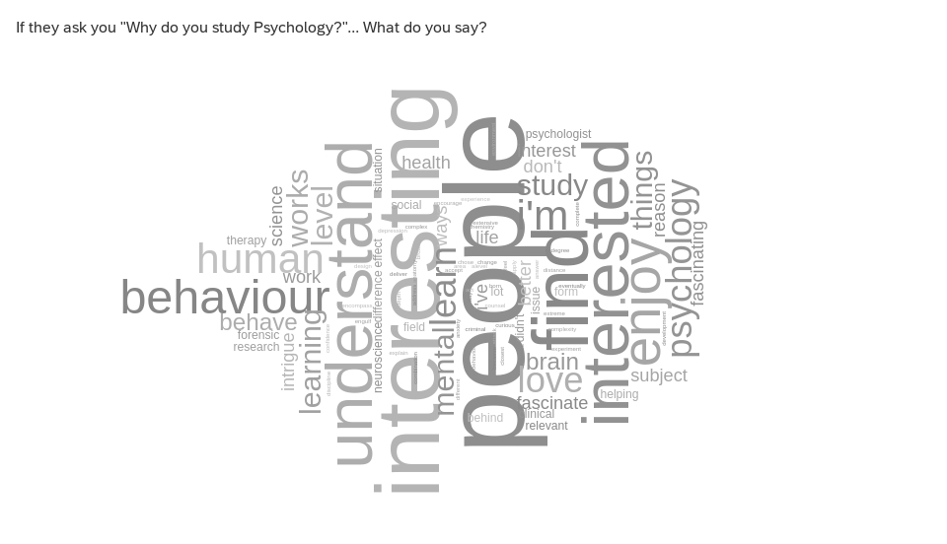

Slide 14
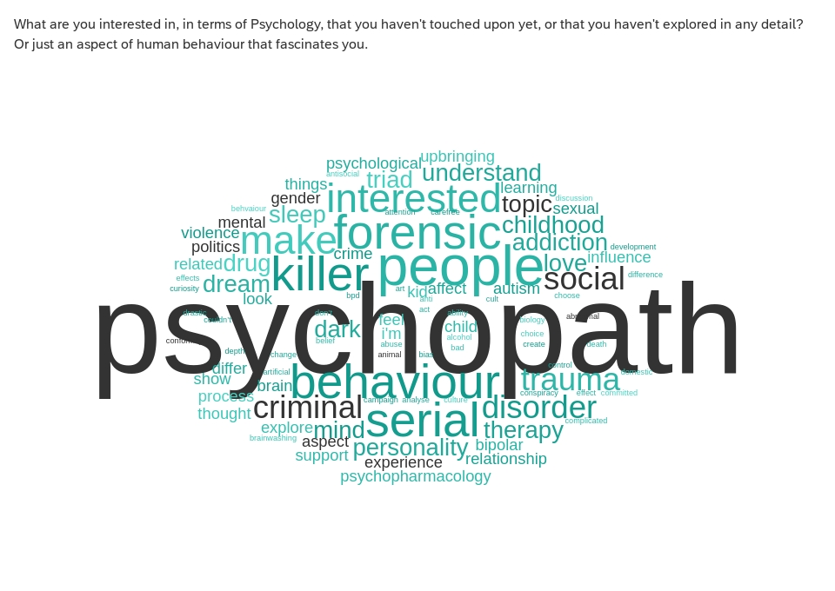

Slide 15
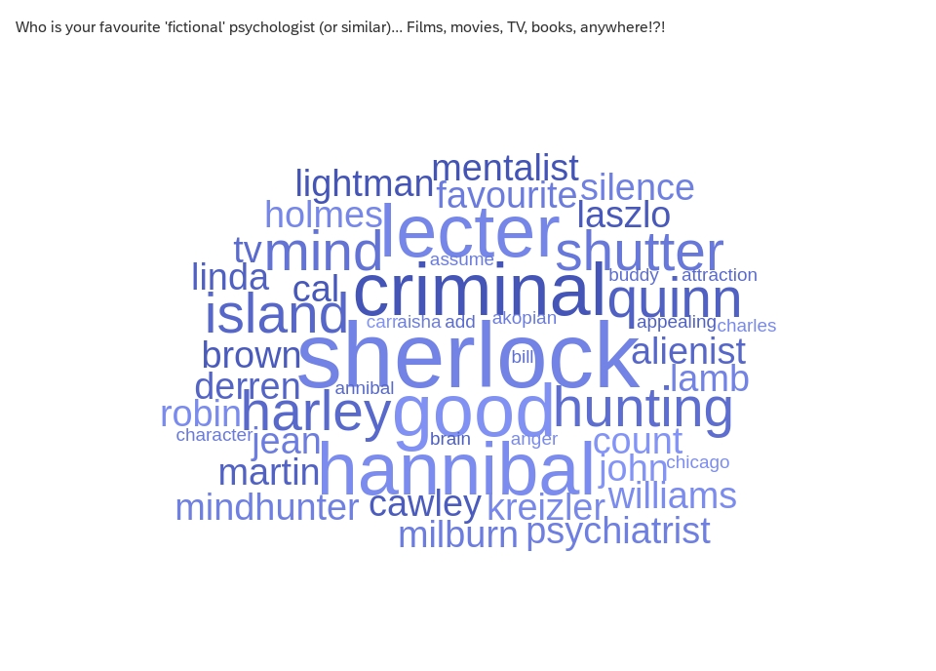

Slide 16
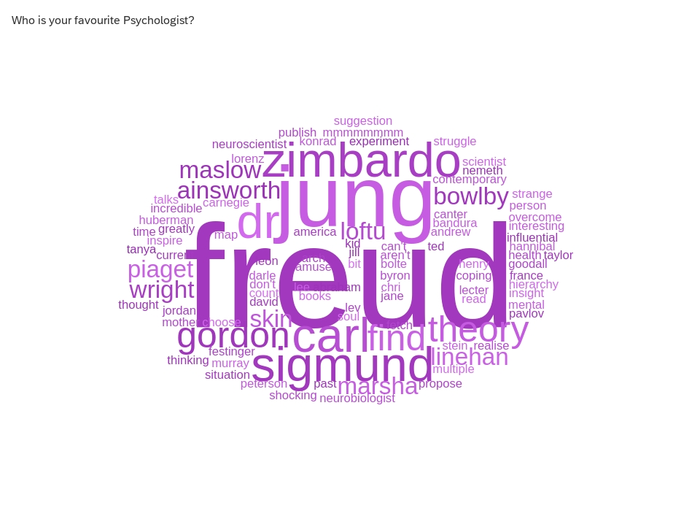

Slide 18
Did you break out the popcorn for the ‘Prelude’?

Slide 19
Did any of you enjoy my movie recommendations?
Did you pick up on the theme?
I’d actually already kinda introduced it…

Slide 20
from last week

Slide 22
A confession
I didn’t make that article ‘I’ wrote terribly obvious
for a reason
it felt a bit weird
I didn’t write it
But there isn’t really anything stopping me claiming so…
Or is there?

Slide 23
A conundrum
I’m going to be fiercely recommending the use of AI tomorrow.
And ALSO warning you against its use elsewhere
huh?

Slide 24
CHIP topics
I want to briefly draw your attention to the third (final) piece of coursework for this module, the so-called ‘CHIP Learning Log’
The earlier we flag topics and introduce little glimmers of content, the easier that will be.
1 - What is Science? An amazing opportunity to consider this while you do your Mini-Dissertation
(A more reliable overview from Professor Ed Diener here) Open Educational Resource
Diener, E. (2022). Why science?. In R. Biswas-Diener & E. Diener (Eds), Noba textbook series: Psychology. Champaign, IL: DEF publishers. http://noba.to/qu4abpzy
2 - Artificial Intelligence - Promise or Peril?

Slide 25
CHIP topic approval process
Anyone can suggest a topic, by identifying where it sprang to mind.
people need to approve it by confirming it is relevant, with a brief rationale.
The more you engage, the more topics you get to choose from.
A concept or debate within Psychology
A historical issue or controversy
A methodology or approach and its promises or limitations
A distinctive or divisive topic
A modern innovation or applied challenge
https://www2.open.ac.uk/openlearn/CHIPs/

Slide 26
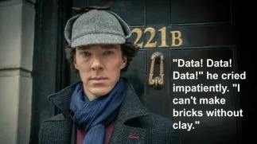
A psychologist? A scientist?

Slide 27
Prize for guessing my favourite Psychologist

Slide 28
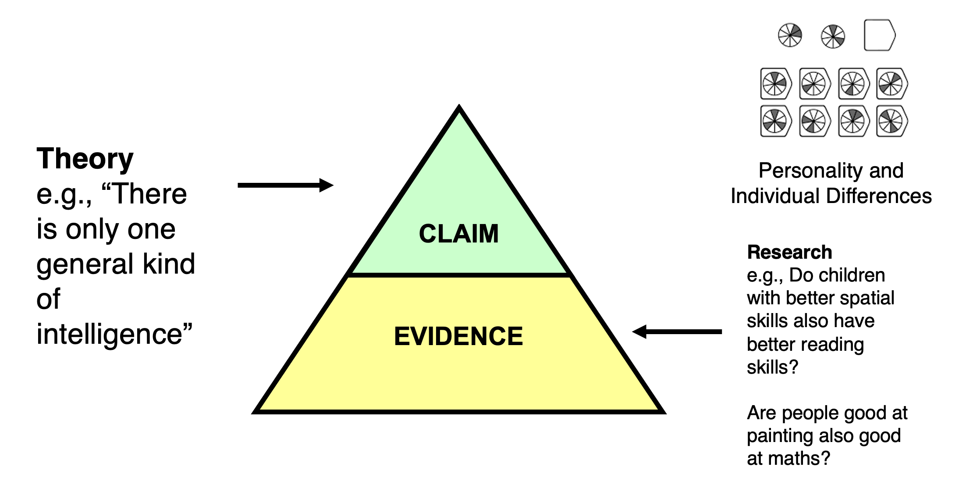
Scientists base their ‘claims’ on EVIDENCE

Slide 29
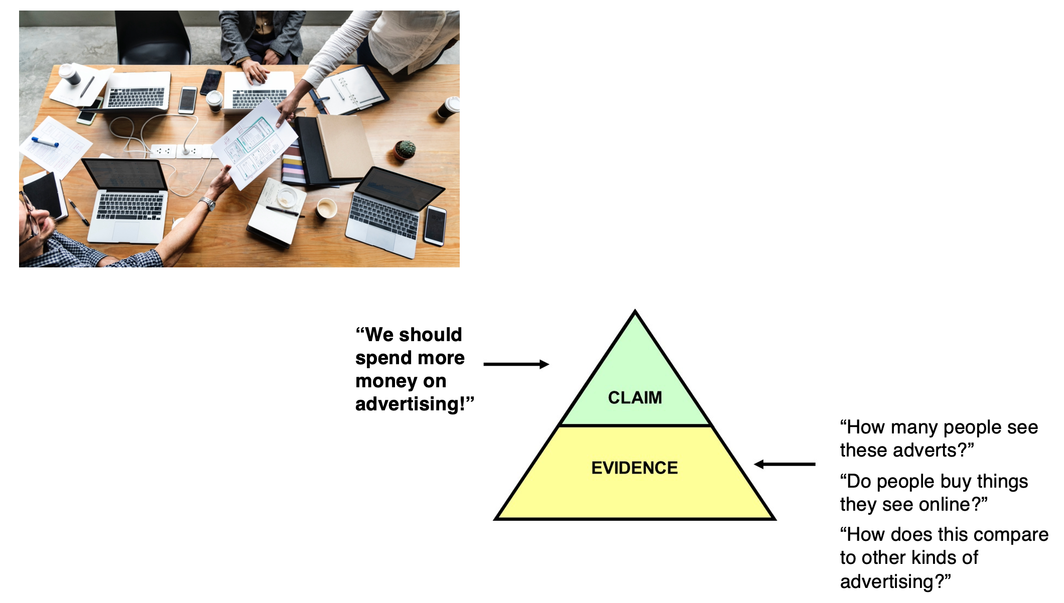
Evidence quality = claim quality!

Slide 30
It starts with a hypothesis

Slide 31
recap on hypotheses

Slide 32
The research process

Slide 33
The simplicity of an experiment

Slide 34
Operationalisation

Slide 35
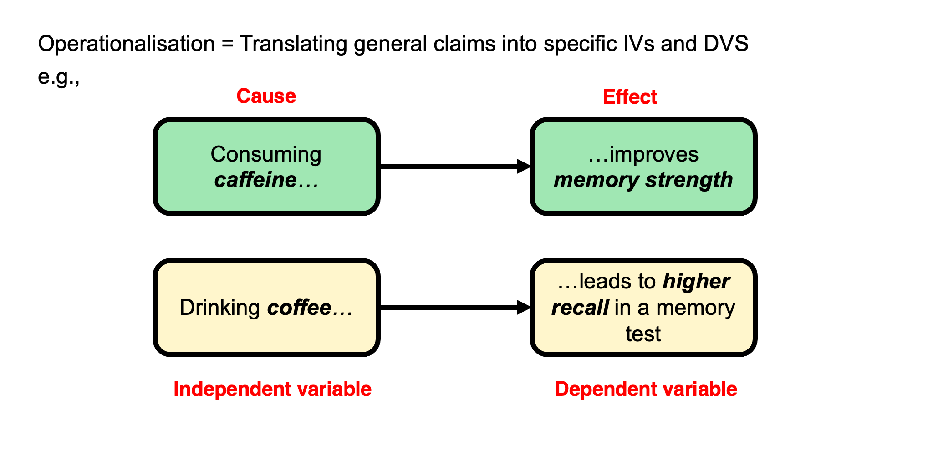
The challenge of operationalisation

Slide 36
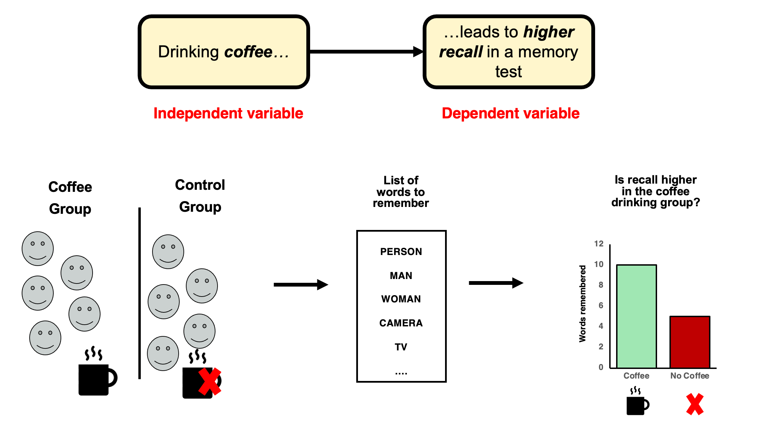
A toy example

Slide 37
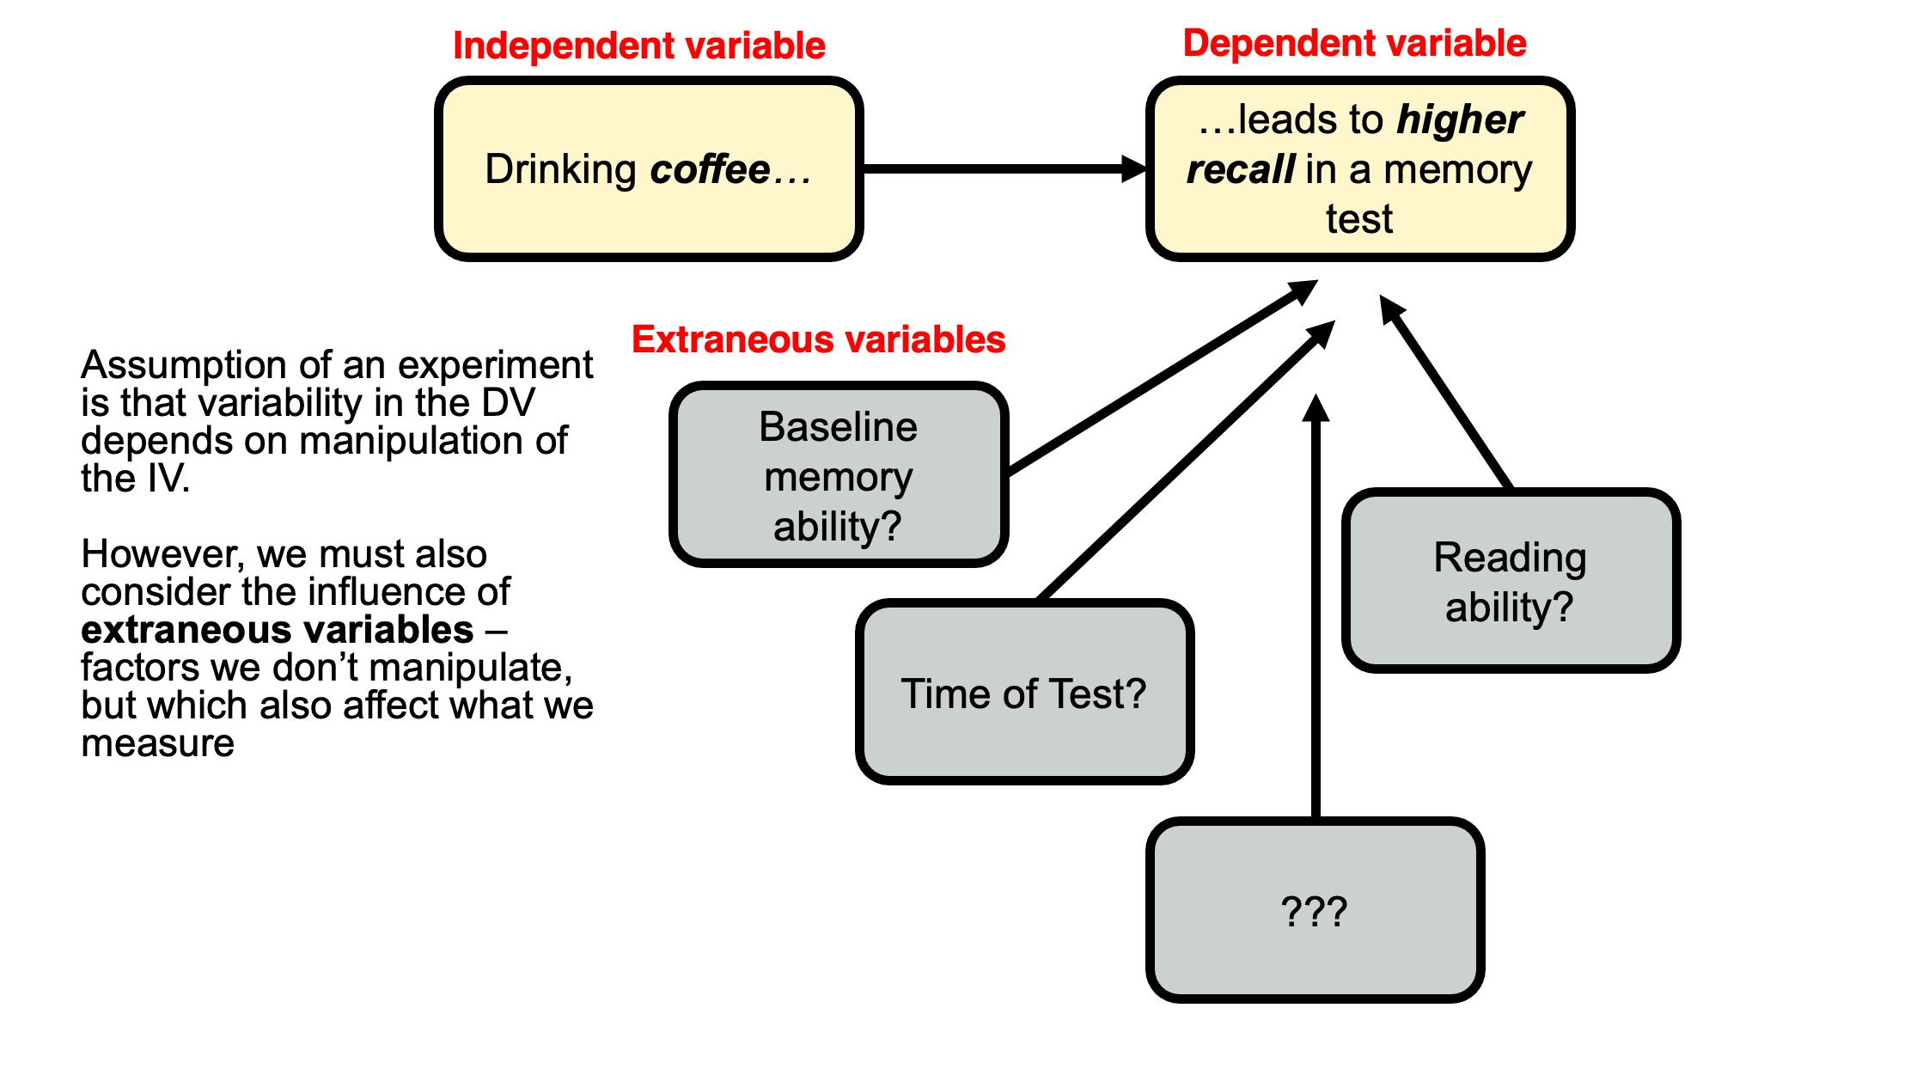
Extraneous variables

Slide 38
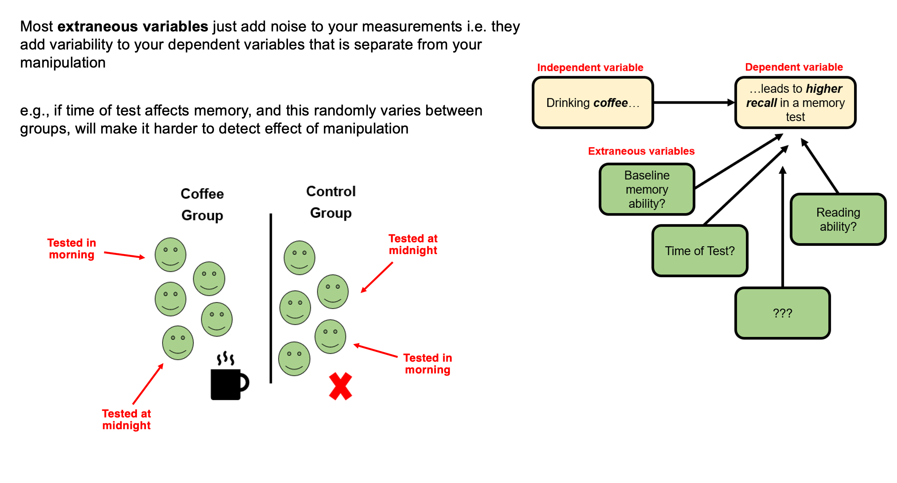
Usually…

Slide 39
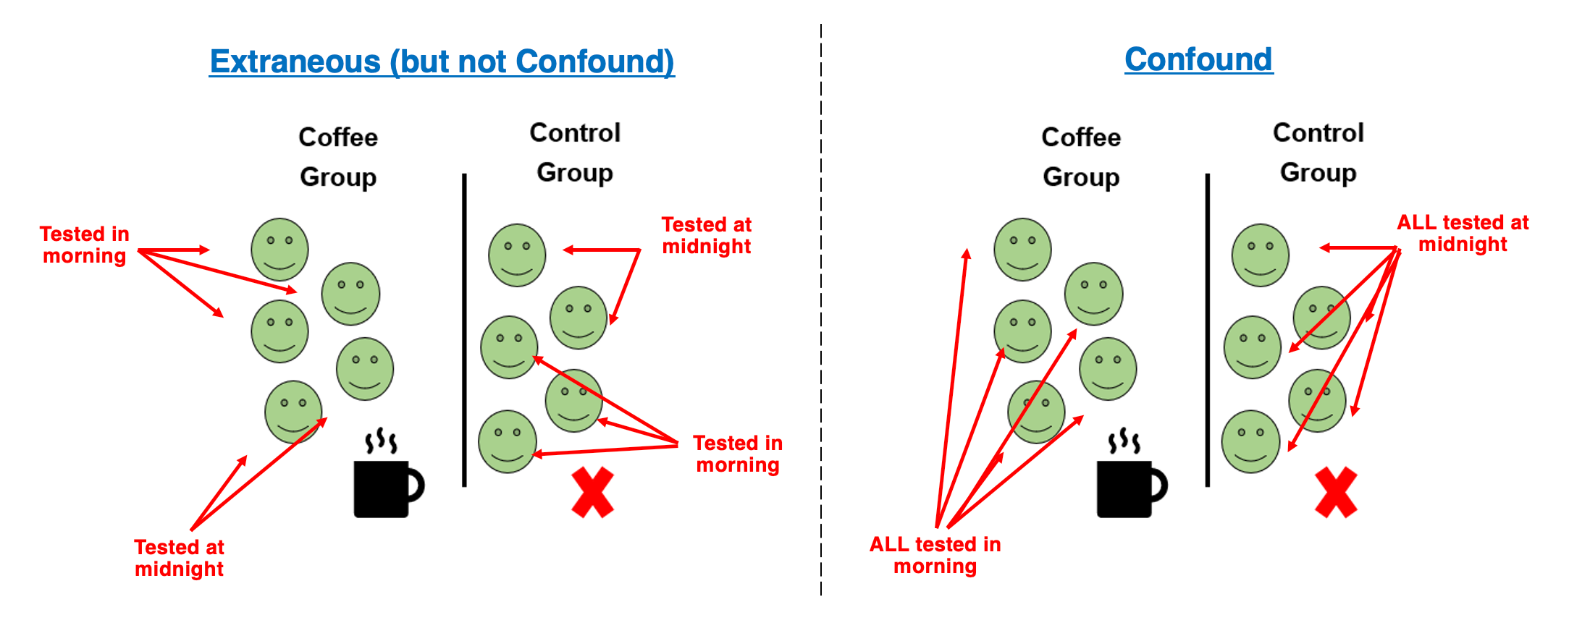
but occasionally…
you hear of ‘confounds’ or ‘confounding variables’
A confounding variable is an extraneous variable that systematically varies with one of your independent variables. These are rare, but nothing can save the experiment.

Slide 40
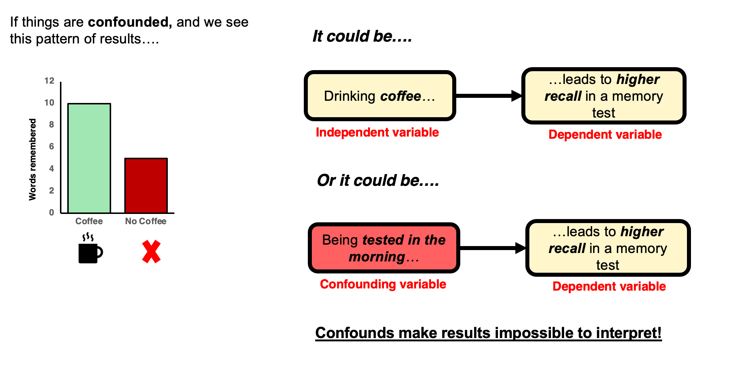
An impossible interpretation

Slide 41
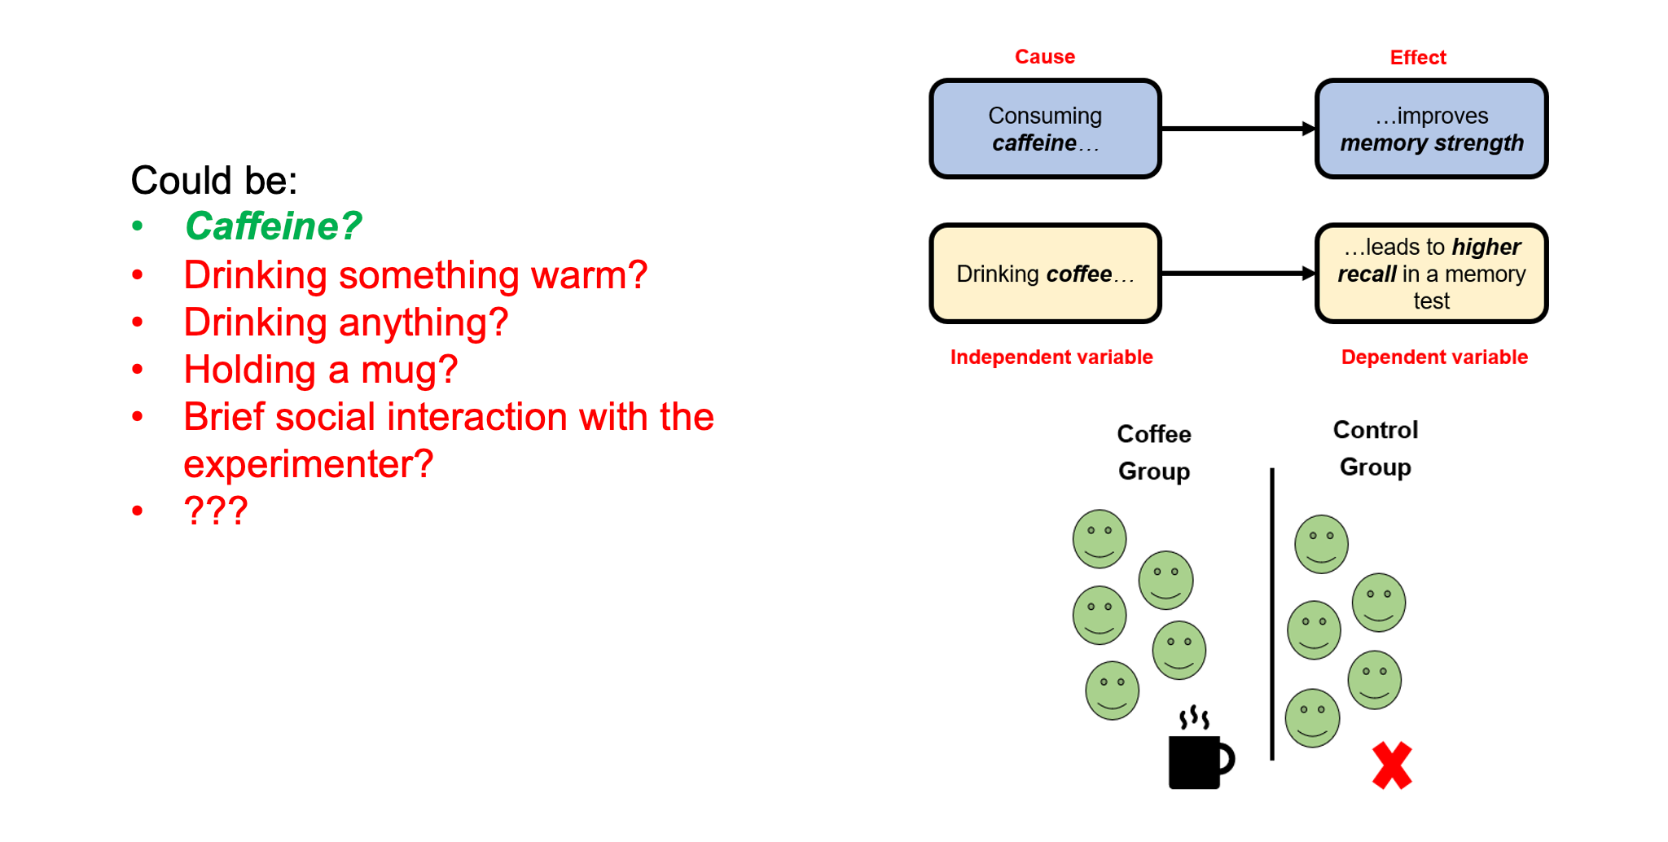
Manipulations almost always introduce potential confounds

Slide 42
Experimental skill + careful thought + piloting + randomness!

Slide 43
The importance of operationalising your variables well

Slide 44
Reading along
I highly recommend reading along with the general topics we cover in the first few weeks.
Research Methods in Psychology by Dennis Howitt and Duncan Cramer is excellent. Chapter 2 in that book (right at the top of the module reading list and here) deals with Hypotheses and aims of research, essentially what we cover this week, and Chapter 1 deals with the basics and golden rules of research design and designing good experiments.

Slide 45
Lab preview

Slide 46
Tomorrow
Complete the Pulse
Finalise your groups (3 or 4 people, all from same Personal Tutorial group)
Submit a list of names to your Lab Tutor
Discuss any problems you are facing
Agree a broad general focus for your group research and write it in your lab notebook
This is now functioning and available in the right hand margin of the VLE page. It’s an experiment, so please give feedback!
Start establishing how you are going to work as a team and identifying milestones

Slide 47
Any Questions?

